Slide 1

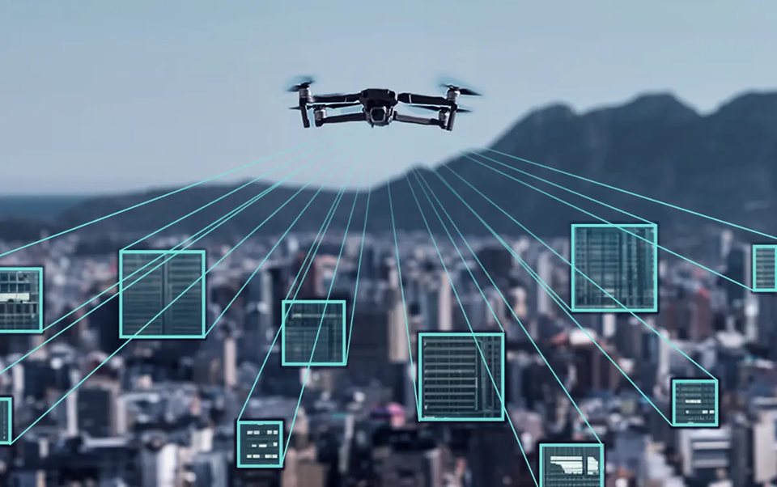

MIHAWK
Mihawk : Drone Surveillance System
Supervised By Mr. Qasim Malik
Notes:
Mention your supervisor, Mr. Qasim Malik, and highlight the innovative aspects of your system.

Slide 2

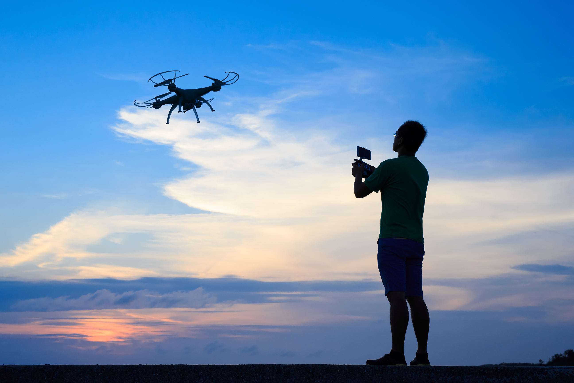

Overview
Introduction
01
Motivation
02
What are the Threats ?
03
Problem
04
Solutions
05
Objectives
06
Core Modules
08
Constraints
09
Project Plan
10
Target Audience
11
Our Team
12
Tools And Technologies
13
FAQs
14
References
17

Slide 3
Introduction
Mihawk aims to revolutionize surveillance systems by using drones for real-time monitoring, threat detection, and blockchain for secure data storage. The system provides :
Enhanced situational awareness
Faster response times
Better threat detection.
Notes:
Relate these benefits to real-world scenarios to keep the audience engaged.

Slide 4

Real-World Security Challenges :
Delayed response times in detecting and reacting to threats.
False alarms leading to inefficiencies and wasted resources.
01
02
Increasing Demand for Advanced Security Solutions :
Rising security threats such as terrorism, theft, and public safety incidents demand more effective and real-time surveillance technologies.
Motivation
Inspiration from Recent Technological Advancements :
The advancement of drone technology, AI-driven threat detection, and blockchain inspired the development of Mihawk to leverage these cutting-edge technologies for real-time surveillance.
03
04
Personal Interest and Passion :
The team’s personal interest in security technology, AI, and drone innovations played a significant role.
Notes:
Address security challenges like delayed threat detection and false alarms.Explain the growing demand for advanced surveillance due to rising threats.Cite recent technological advancements in drones, AI, and blockchain.Personal Passion: Mention the team’s interest in security and drone innovations.

Slide 5
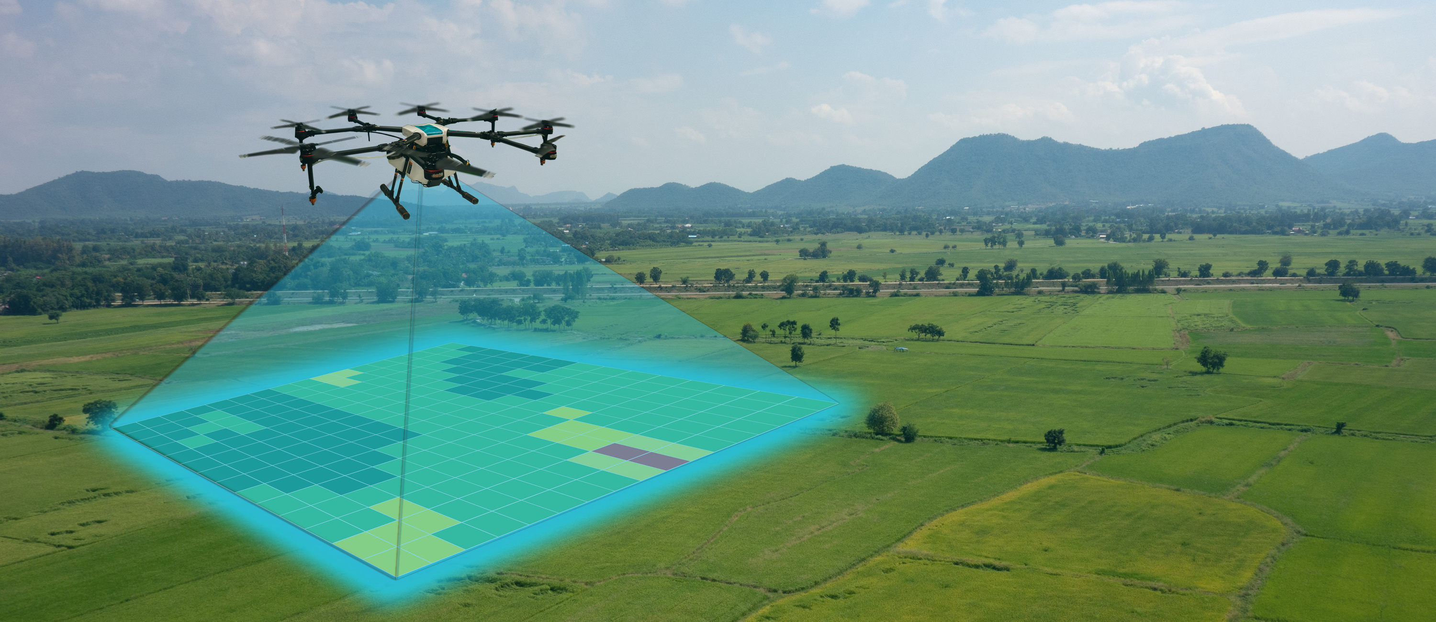
What are the Threats ?
Mihawk is designed to address several real-world security threats, including:
Unattended Baggage
Weapons and Knives
Street Brawls/Fights
Notes:
List the threats Mihawk is designed to address:Unattended baggage
Weapons and knives
Street brawls/fights
Focus: Explain how traditional systems fail to address these threats and how Mihawk fills that gap.

Slide 6

Problem
Limited Coverage
Delayed Threat Detection
Operational Inefficiency
Traditional surveillance systems rely on static cameras, which create blind spots and leave areas unmonitored, increasing security risks.
Traditional surveillance systems rely on static cameras, which create blind spots and leave areas unmonitored, increasing security risks.
Static surveillance systems demand significant human oversight, which can be resource-intensive and lead to inefficient security management.
Notes:
Key Points: Discuss the limitations of traditional surveillance systems:
Limited Coverage: Blind spots due to static cameras.
Delayed Detection: Slow identification of threats.
Operational Inefficiency: High human oversight needed.
Focus: Emphasize the need for a dynamic, more efficient solution.

Slide 7
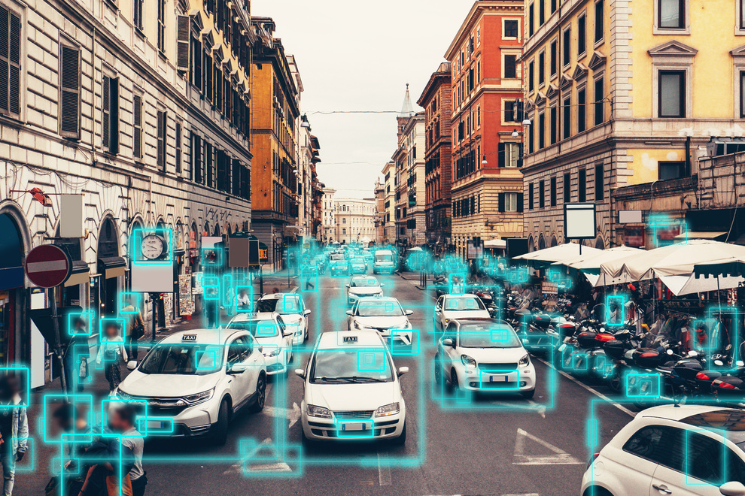

Solutions
Dynamic Surveillance Coverage
Real-Time Threat Detection
Immediate Alerts and Notifications
Mihawk utilizes advanced drone technology to achieve dynamic surveillance coverage across expansive areas.
Mihawk employs sophisticated algorithms for real-time video processing and object detection, enabling immediate identification of potential threats.
Mihawk is designed to generate instant alerts for any detected threats, ensuring that security personnel can take prompt action when necessary.
Notes:
Key Points:
Improved Surveillance: Eliminate blind spots with drones.
Real-Time Alerts: Detect and notify threats in real-time.
Improved Detection: Increase the accuracy of threat detection.
Focus: How Mihawk’s objectives solve real-world problems.

Slide 8
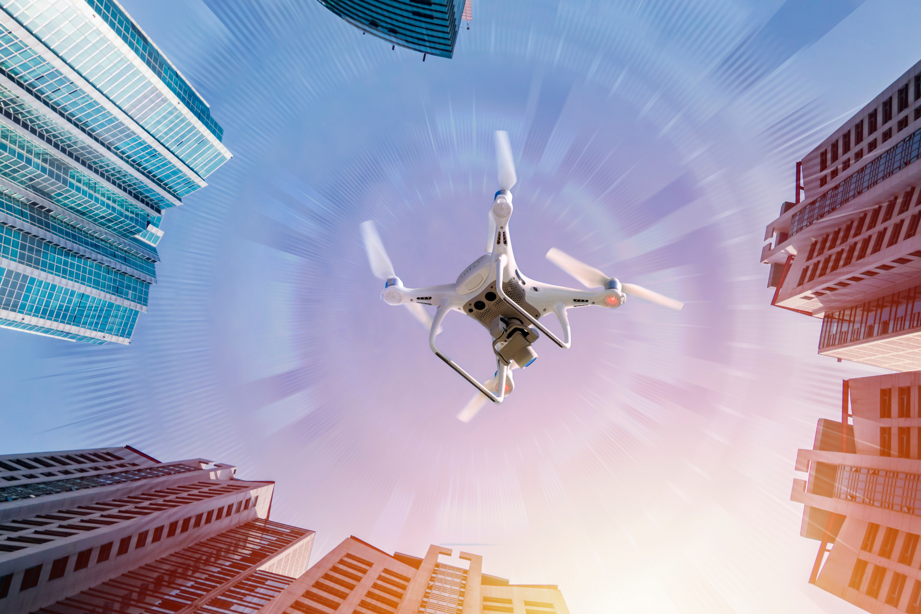
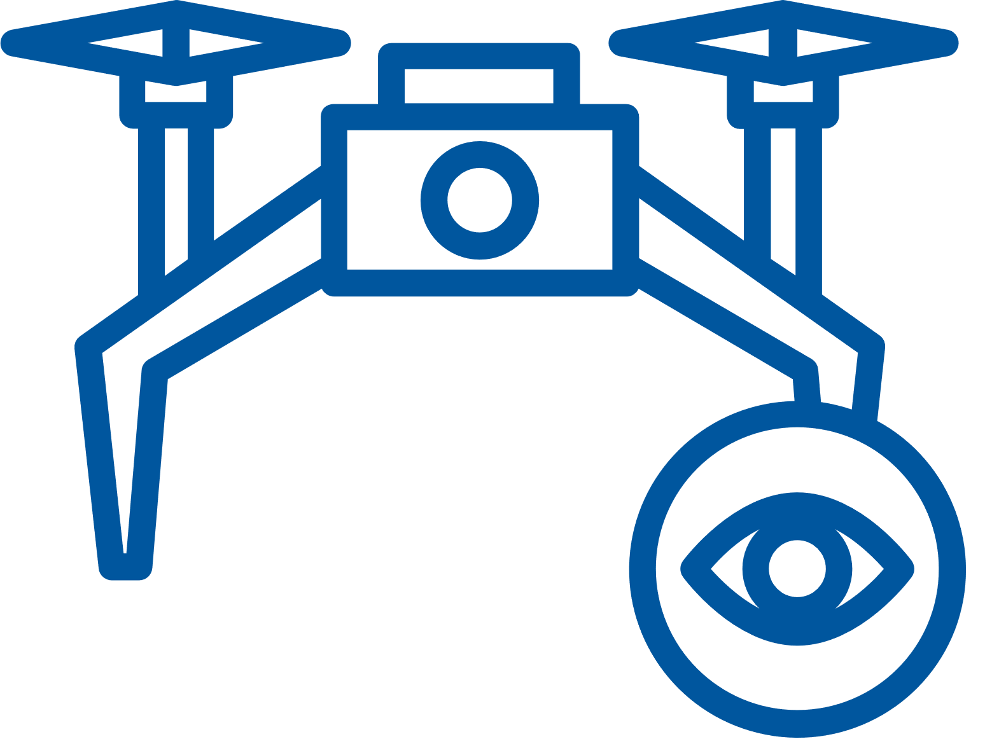


Objectives (I)
Improved Surveillance
Real Time Alerts
Improved Detection
Improve surveillance coverage by eliminating blind spots through manual drone control
Detect and notify authorities of security threats in real-time.
Increase the accuracy of detecting security-related events.
Notes:
Key Points:Response Time: Faster reactions to potential incidents.
Early Threat Detection: Use predictive analytics to detect threats early.
Data Security: Ensure secure and tamper-proof data through blockchain.
Focus: Highlight how these objectives will make Mihawk effective in high-risk areas.

Slide 9


Objectives (II)
Responce Time
Early Threat Detection
Data Security
Reduce response times to potential incidents
Integrate predictive analytics for early threat detection​
Enhance data security and integrity through blockchain integration for all surveillance data.

Slide 10
Surveillance and Threat Detection:
Real-time video processing for object detection and crowd behavior analysis.
Advanced AI algorithms to identify security threats like weapons, suspicious objects, or behaviors.
01
Alert Management:
Immediate notifications for identified threats, ensuring rapid response.
Priority-based alert categorization, enabling faster action for high-risk situations.
02
Core Modules
Blockchain Integration:
Secure and tamper-proof storage of surveillance footage and event logs.
Data encryption to ensure the privacy and integrity of captured data.
03
User Management:
User authentication and authorization for secure system access.
Role-based access control to restrict system functions based on user permissions.
04
Notes:
Key Points:Surveillance and Threat Detection: Real-time video and AI algorithms.
Alert Management: Immediate threat alerts and priority-based responses.
Blockchain Integration: Secure storage and encrypted data.
User Management: Role-based access control and security.
Focus: Emphasize the real-time capabilities and security focus of Mihawk.

Slide 11
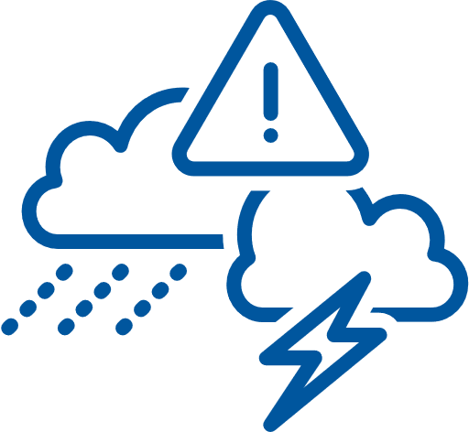


Constraints
Battery Life of Drones
Adverse Weather Conditions
Regulatory Compliance
Challenge: Limited flight time due to battery capacity.
Impact: Surveillance coverage may be interrupted, requiring drones to return for recharging.
Mitigation: Optimized flight paths and rapid battery swapping.
Challenge: Weather such as heavy rain, strong winds, or fog can impact drone performance.
Impact: Reduced visibility, compromised data accuracy.
Mitigation: Integration of weather APIs for predictive adjustments.
Challenge: Stringent regulations imposed by aviation authorities.
Impact: Limited areas for drone operation and restrictions on altitude and distance.
Mitigation: Ensuring compliance with local regulations.
Notes:
Key Points:Battery Life: Drones may require recharging, but optimized flight paths and rapid battery swapping mitigate this.
Adverse Weather Conditions: Integration with weather APIs helps adjust flight paths.
Regulatory Compliance: Ensure adherence to aviation regulations.
Focus: Acknowledge these challenges and present your solutions to manage them.

Slide 12



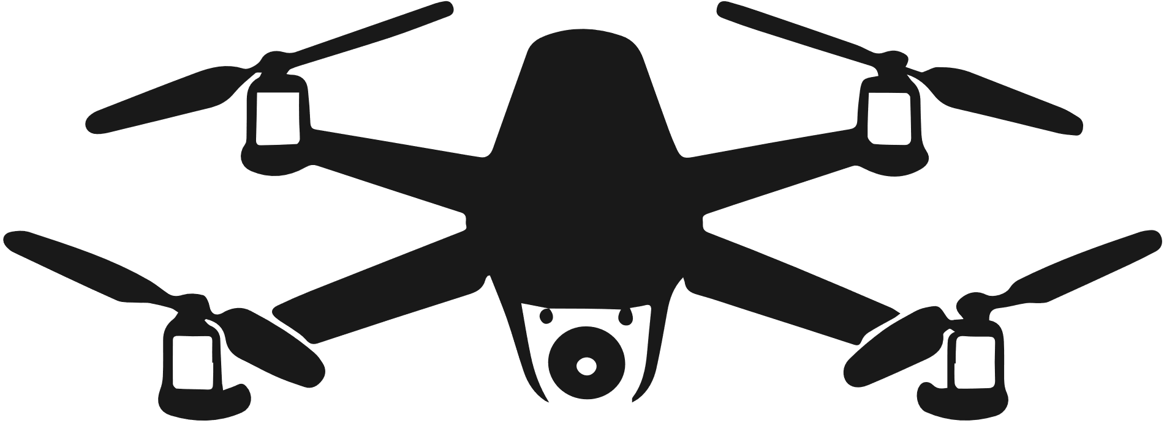

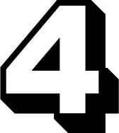
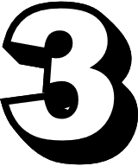
Project Plan
ITERATION 1
ITERATION 5
Website Development and Machine Learning Model Setup
Final Tweaks and Additional Features
ITERATION 2
ITERATION 4
Advanced Drone Control and Real-time Monitoring
Blockchain Integration and Data Management
ITERATION 3
Advanced Surveillance and Threat Detection
Notes:
Key Points: Outline the project iterations:
Website and Machine Learning setup.
Advanced drone control and monitoring.
Surveillance and threat detection.
Blockchain and data management.
Final tweaks and additional features.
Focus: Provide a clear roadmap for the project’s development.

Slide 13



Our Target Users
Private Security Firms
Law Enforcement
Public Safety Authorities
Private companies offering surveillance services for events, private properties, or high-risk areas.
Government bodies responsible for national and regional security.
City governments or municipalities overseeing public safety and crowd management in large urban areas.
Notes:
Key Points:Private Security Firms
Law Enforcement
Public Safety Authorities
Focus: Highlight how different sectors can benefit from Mihawk’s technology.

Slide 14



Our Team
Usman Malik
Hozefa Rauf
Hammad Alvi
CEO & Founder
AI/ML Engineer
Full Stack Developer
blockchain enthusiast

Slide 15








Tools
Tool Names
REACTJS
NODEJS
PYTHON
MONGO
DOCKER & K8S
Blockchain
Usman Malik
Hozefa Rauf
Hammad Alvi
Notes:
Key Points: List the technologies used:
ReactJS, NodeJS, MongoDB, Python, Blockchain, Docker, and K8S.
Focus: Briefly describe how these tools contribute to Mihawk’s functionality.

Slide 16
FAQ
How does Mihawk detect threats?
Mihawk uses AI-driven algorithms to analyze live surveillance footage in real time. These algorithms are capable of object detection (e.g., weapons, suspicious items) and behavior analysis (e.g., crowd movements).
What role does blockchain play in the system?
We will use the blockchain technology to store and retrieve flagged video footage or frames, making it highly secure and trustworthy for future reference or legal purposes.
How does Mihawk reduce false alarms?
Mihawk's AI-driven threat detection continuously learns from patterns and behaviors, improving its accuracy over time.
How will you find the datasets for the project or are the datasets publicly available ?
Yes the datasets required to implement and make models are publicly available and included in the references

Slide 17
FAQ
Can Mihawk operate autonomously or does it require manual control?
We will make sure Mihawk offers both manual flight control for precise navigation and the ability to automate certain tasks, such as routine surveillance or threat detection.
How is video streamed from the drone to the control interface?
We will uses the Real-Time Streaming Protocol (RTSP) via Raspberry Pi integration to transmit high-resolution video from the drone’s camera to the control interface. This ensures live, uninterrupted video feeds that can be monitored through a web application or command center interface
How scalable is the system for large areas?
We will design Mihawk to be highly scalable, capable of monitoring large areas by deploying multiple drones simultaneously. The system's cloud-based architecture ensures that data from different drones can be centrally processed and analyzed, making it suitable for extensive surveillance operations.

Slide 18
FAQ
What happens if the drone encounters adverse weather conditions?
We will make sure Mihawk integrates weather APIs that allow the system to adjust flight paths or operations based on real-time weather data. In extreme conditions, drones may return to base or switch to alternative surveillance methods, such as ground-based cameras.
What types of threats can Mihawk detect?
Mihawk is capable of detecting a range of security threats including:
Weapons (e.g., firearms, knives).
Unattended objects (e.g., suspicious packages).
Unauthorized drones.
Crowd anomalies (e.g., riots, aggressive behavior). These threats are identified using object detection and AI algorithms.
How is user access managed within the system?
We will incorporate a User Management module that handles authentication, authorization, and role-based access control. This ensures that only authorized personnel can access sensitive data and functions within the system. Features like 2-Factor Authentication (2FA) further enhance security.

Slide 19
Hyperledger Fabric:
Describes the architecture of a distributed operating system for permissioned blockchains, crucial for secure and scalable data storage in our project.
(E. Androulaki et al., EuroSys, 2018).
01
DroneKit Library :
A Python library that provides easy-to-use APIs for drone control, enabling real-time monitoring and automation in drone applications.
(T. Martin et al., IEEE IROS, 2016)
02
References
Real-Time Video Streaming :
Discusses best practices for implementing real-time video streaming, ensuring efficient data handling and low-latency performance in surveillance.
(J. Doe, Streaming Media, 2023)
03
04
AES Encryption :
A widely used encryption standard that ensures secure transmission and storage of sensitive surveillance data.
(NIST, 2001)

Slide 20
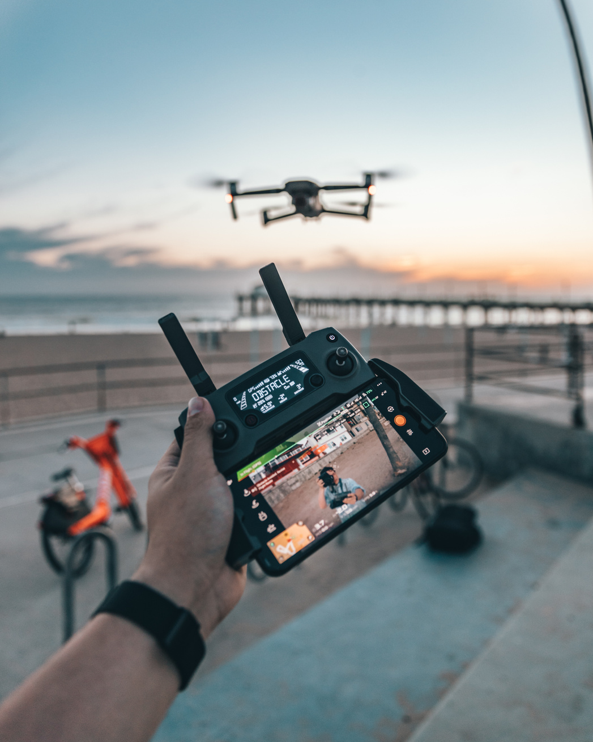

MIHAWK
THANK YOU!

